Slide 1
Pathophysiology and Therapeutics: Cirrhosis, End Stage Liver Disease (ESLD)
Lawrence Carey, PharmD
Temple University School of Pharmacy

Slide 2
Objectives
Describe the pathophysiological findings of cirrhosis and end stage liver disease
List major complications of cirrhosis
Recommend pharmacological therapy for such complications
Design an appropriate monitoring plan with regard to efficacy and toxicity of agents used to treat cirrhosis and its complications
Notes:
2:15

Slide 3
Setting The Table

Slide 4
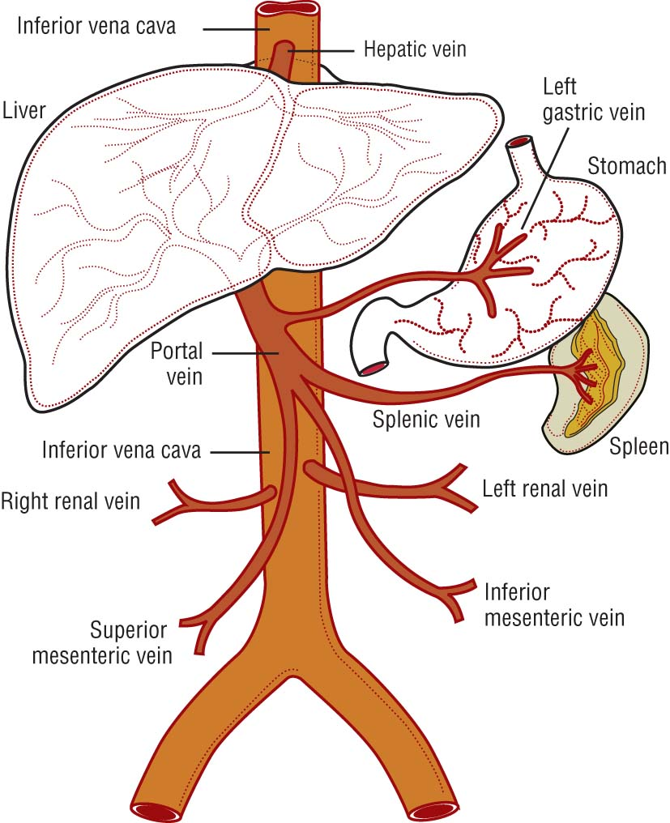
The Hepatic System
Portal Venous System
Sease JM. In Pharmacotherapy, 8th ed. 2011.
Liver receives blood primarily from hepatic artery/portal vein
Portal blood comes from mesenteric, gastric, splenic, and pancreatic veins
Enters via “portal triad”:
Portal vein/hepatic artery
Bile ducts
Lymphatic/nerve tissue

Slide 5
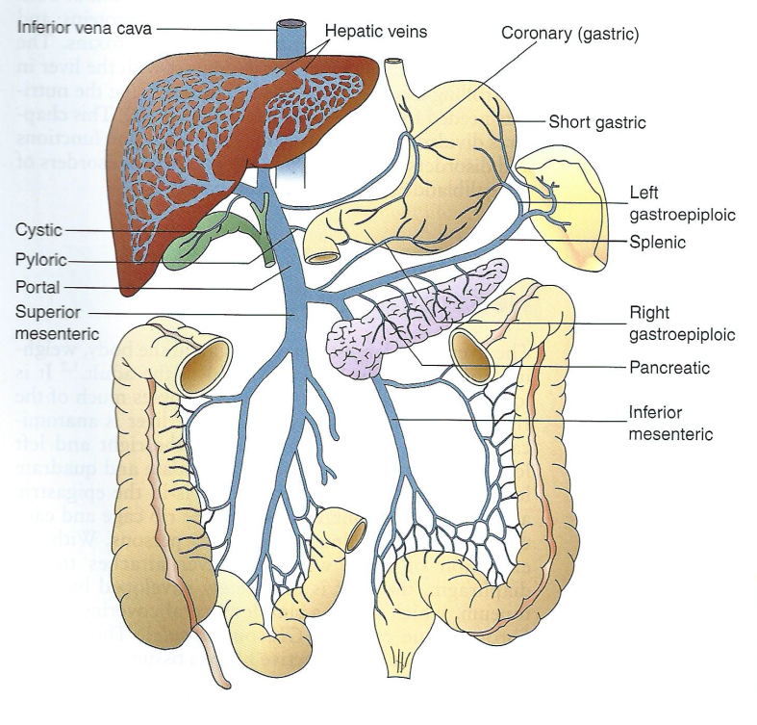
Another View: Portal Circulation
Porth CM. In Essentials of Pathophysiology, 3rd edition, 2011.
Blood from GIT, spleen, and pancreas travels to liver through portal vein
After going through portal vein, blood moves into vena cava for return to heart
Lobule: functional unit of liver

Slide 6
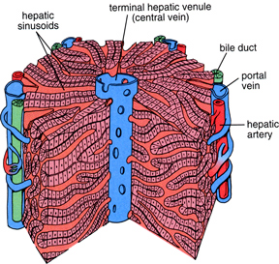
Hepatic Blood Flow
Cross Section of Hepatic Lobule
www.graphicwitness.com/netter/gallery/gallery2.htmlanatomy.iupui.edu...04.html
Central vein: collects filtered blood, empties into larger hepatic vein and inferior vena cava
Bile duct: collects bile to store in gall bladder
Portal vein: entry of deoxygenated blood from spleen, intestine, & stomach circulation
Hepatic artery: entry of oxygenated blood to the liver from heart

Slide 7
Hepatic Blood Flow
Cross Section of Hepatic Lobule
www.graphicwitness.com/netter/gallery/gallery2.htmlanatomy.iupui.edu...04.html
Hepatic sinusoids: part of lobule where blood drains
Sinusoidal spaces lined by hepatocytes
Hepatocytes arranged in plates that are one cell thick
Filtration occurs as blood enters the lobule and passes through the sinusoidal spaces lined with hepatocytes
Filtered blood → central veins → larger hepatic veins → inferior vena cava

Slide 8
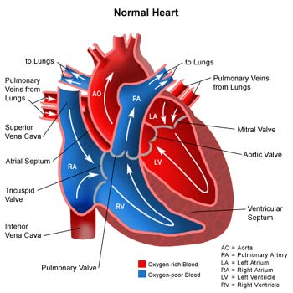
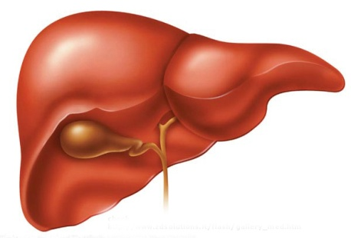
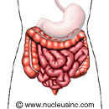
Summary: Hepatic Blood Flow
Inferior vena cava
Aorta
Hepatic artery
Hepatic vein
Liver
Arteries to digestive tract
Portal vein
Stomach, Intestine, and Spleen

Slide 9
The Hepatocyte: Functions
Hepatocytes = hepatic parenchyma
Account for 70-80% of liver’s mass
Hepatocytes closer to portal triad have most oxygen saturation capacity
Also higher levels of glutathione, glucagon synthesis
Detoxification occurs within the hepatocyte
Phase I and phase II metabolism
Stellate cells: store vitamin A, maintain matrix
LD: proliferate, fibrose → loss of hepatocyte function
Notes:
1125

Slide 10
Functions of the Liver
Conjugates bilirubin (produces bile)
Synthesis and/or storage
Albumin
Clotting factors
Glucose, cholesterol, transport proteins
Metabolism of fats, carbs, protein, drugs
Formation of ammonia from protein
Notes:
14:40
Protein is problematic in hepatic patients

Slide 11
Functions of the Liver
Conjugate
bilirubin
Synthesize
albumin
LIVER
Metabolism
Synthesize
clotting
factors
Storage, synthesis & use of
nutrients
Notes:
Conjugates Bilirubin- produces bile
Nutrients:
Storage- glycogen
Synthesis- glucose, cholesterol, transport proteins
Use/Metabolism- Metabolism of Fats, Carbs, protein, → formation of ammonia from protien

Slide 12
The Bilirubins
Formed from senescent RBCs
Hemoglobin in RBC broken down to biliverdin
Hemoglobin broken down in spleen/bone
Biliverdin converts to unconjugated bilirubin
Unconjugated a/k/a free a/k/a indirect
Unconjugated bilirubin passes through liver → converted to conjugated (direct) bilirubin
Now is soluble in bile
Notes:
21:25

Slide 13
The Bilirubins
Once in bile:
Bile ducts → small intestine → excreted in feces
Can also reabsorb back to liver, or
Can be reabsorbed from intestine to blood and kidney
Then is excreted by kidneys in urine
Notes:
2305

Slide 14
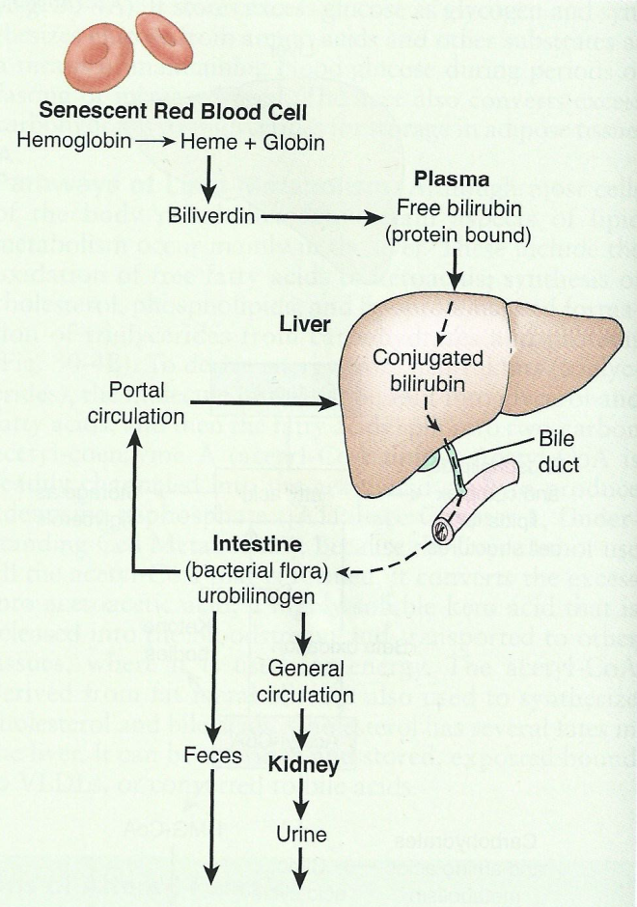
The Bilirubins: Formation, Circulation, Elimination
Porth CM. In Essentials of Pathophysiology, 3rd edition, 2011.

Slide 15
Metabolism
Phase I Metabolism
First phase of metabolism in the liver
Utilizes CYP450 enzymes
Oxidation, reduction, hydrolysis
Significantly altered by cirrhosis/ESLD
Phase II Metabolism
Second phase of metabolism in the liver
Conjugation
Glucuronidation
Sulfation
Generally not significantly altered by cirrhosis/ESLD
Notes:
26:30

Slide 16
Synthesizing Functions
Synthesis/Excretion
Glucose
Cholesterol
Transport/carrier proteins
Ammonia → urea
Albumin
Clotting Factors
Detoxification
Storage
Glycogen
Bilirubin/Bile
Vitamins A, D, B12
Folic acid
Bacteria-fighting cells
Utilization
Protein metabolism
Carbohydrate metabolism
Lipid metabolism

Slide 17
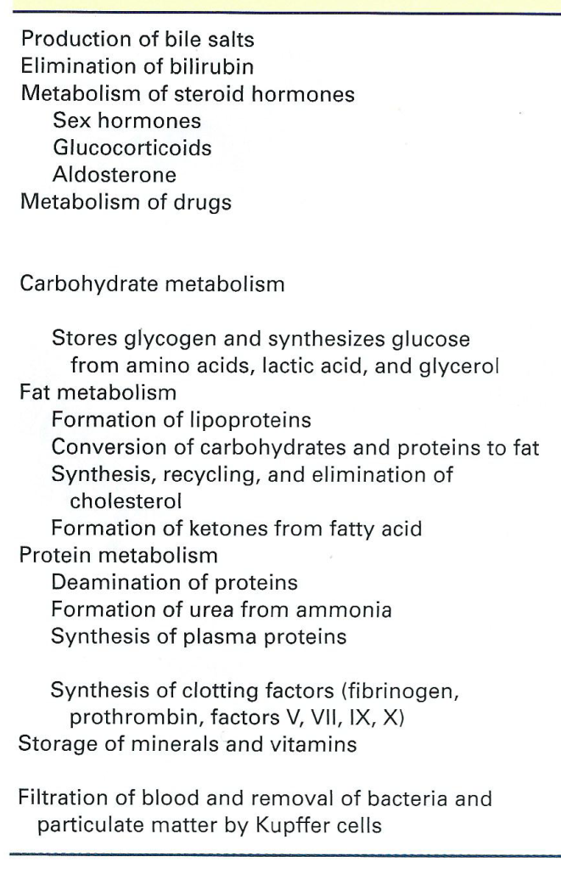
Summary: Functions of the Liver
Porth CM. In Essentials of Pathophysiology, 3rd edition, 2011.

Slide 18
Cirrhosis, ESLD

Slide 19
Important Terms
Alcoholic liver disease (ALD)
Spectrum from simple steatosis to cirrhosis
Steatosis
Fatty deposits
Not always a cirrhosis precursor except in nonalcoholic steatohepatitis (NASH) or ALD
Cirrhosis
Fibrotic changes
End-stage liver disease →death unless transplant

Slide 20
Cirrhosis
12th leading cause of death in USA
Accounts for > 28,000 deaths and > 350,000 hospital discharges per year
Criteria for cirrhosis development:
80 grams of ethanol daily for 10-20 years
This equals one liter of wine, eight 12 ounce beers, or eight ounces of hard liquor per day
Contrast: alcoholism = 60-80 grams ethanol daily (about 6-8 drinks per day) over many years
Minino AM et al. Natl Vital Stat Rep 2006;54:1-7.
Notes:
36:00

Slide 21
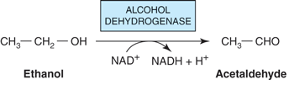
Etiology: Alcoholic Liver Disease
Formation of reactive oxygen species which damage hepatocytes
Inhibits oxidation of fatty acids = increased production of triglycerides
Murray RK, Bender DA, Botham KM, Kennelly PJ, Rodwell VW, Weil PA: Harper’s Illustrated Biochemistry, 28th Edition: http://www.accessmedicine.com
Notes:
7-8% of adults in America meet DSM criteria for EtOH abuse &/or dependence
44% of all deaths from liver disease were attributed to EtOH (2003)
40% of those with modest alcohol intake (≤10 g/day) also exhibit fatty changes
-----------------------------------------------------
Alcohol is the drug that most commonly produces steatonecrotic changes in the liver. When alcohol is converted into acetaldehyde, the synthesis of fatty acids is increased.17,18 The hepatocyte can become completely engorged with microvesicular fat, resulting in alcoholic fatty liver. Metabolically this type of de novo free fatty acid synthesis depletes NADPH in favor of NADP+ and reduces the hepatocytes' ability to respond to stress, bypassing normal apoptosis and increasing the rate of necrocytolysis.
--------------------------------------
The fat accumulation in the liver is caused by a combination of impaired fatty acid oxidation and increased lipogenesis, which is thought to be due to changes in the [NADH]/[NAD+] redox potential in the liver, and also to interference with the action of transcription factors regulating the expression of the enzymes involved in the pathways. Oxidation of ethanol by alcohol dehydrogenase leads to excess production of NADH.
The NADH generated competes with reducing equivalents from other substrates, including fatty acids, for the respiratory chain, inhibiting their oxidation and causing increased esterification of fatty acids to form triacylglycerol, resulting in the fatty liver. Oxidation of ethanol leads to the formation of acetaldehyde, which is oxidized by aldehyde dehydrogenase, producing acetate. The increased [NADH]/[NAD+] ratio also causes increased [lactate]/[pyruvate], resulting in hyperlacticacidemia, which decreases excretion of uric acid, aggravating gout. Some metabolism of ethanol takes place via a cytochrome P450-dependent microsomal ethanol oxidizing system (MEOS) involving NADPH and O2. This system increases in activity in chronic alcoholism and may account for the increased metabolic clearance in this condition.

Slide 22
How Does Alcohol Do Damage?
When alcohol is converted into acetaldehyde, the synthesis of fatty acids is increased
Hepatocyte can become completely engorged with microvesicular fat
Results in alcoholic fatty liver
Metabolically, depletes NADPH in favor of NADP+ →
Reduces hepatocytes' ability to respond to stress →
Bypasses normal apoptosis →
Increases rate of necrocytosis
Notes:
39:00

Slide 23
Definition of Cirrhosis
Fibrosis of hepatic parenchyma resulting in
Altered hepatic function
Restricted venous outflow
Portal hypertension
Also results in
An overall vasodilated state
Activation of RAA
Altered hepatic synthetic function
Development of complications (i.e., ascites)
Tasner YO, Hebert MF. In Applied Therapeutics, 10th edition, 2013.
Notes:
41:00

Slide 24
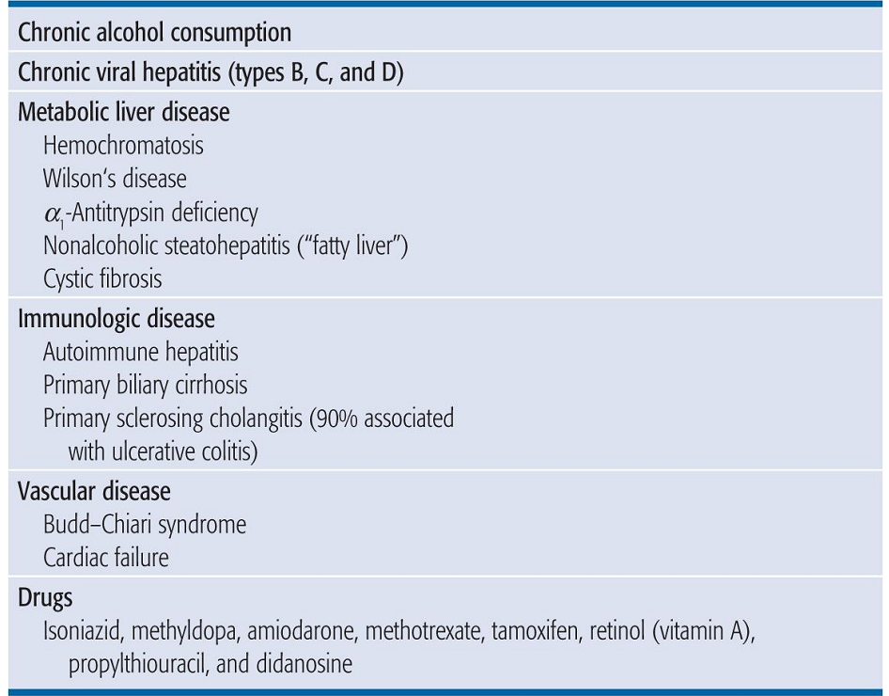
Epidemiology of Cirrhosis
Sease JM. In Pharmacotherapy, 8th edition, 2011.
Other drugs implicated:
Acetaminophen (most common cause of drug-induced liver failure)
Niacin
Kava-kava
Drugs: the leading cause of acute liver failure in patients referred for liver transplant
Navarro VJ. NEJM 2006;354(7):731-39.

Slide 25
Cirrhosis: Pathophysiology
Fibrotic tissue is a result of hepatocyte death
This tissue is non-functional
Blood cannot flow through fibrotic areas
Not detoxified
Backs up, shunted around the liver
Results
Increase liver and portal vein pressures
Decreased metabolic activity
Decreased synthetic function
Notes:
44:50

Slide 26
Patho Bottom Line, Part 1…
Normal liver tissue plus hepatotoxins →
Inflammation, abnormal collagen secretion →
Fibrosis (protein buildup) in attempt to heal →
Collagen builds up →
Bridging cirrhosis →
Frank hepatic cirrhosis →
Chronic liver disease

Slide 27
Patho Bottom Line, Part 2
Replacement of normal hepatic parenchyma by fibrotic tissue →
Resistance to blood flow leads to portal hypertension →
Develop varices and ascites →
Hepatocyte loss, intrahepatic blood shunting →
Diminished metabolic/synthetic function →
Hepatic encephalopathy and coagulopathy
Notes:
46:00

Slide 28
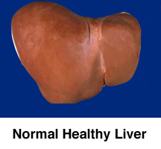
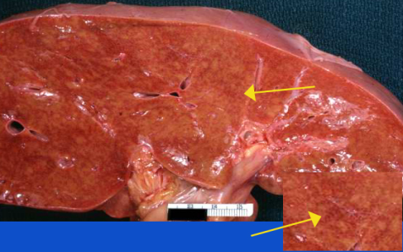
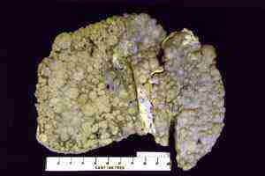
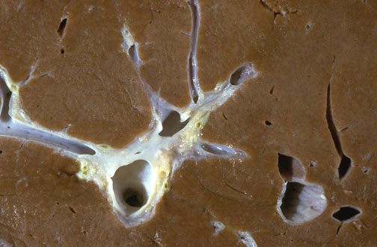
Liver
Fibrosis/
Cirrhosis
Normal
Liver
Fatty
Liver
Hepatitis
Fat deposits accumulate in hepatocytes
(a/k/a steatosis)
No functional impairment
Likely reversible
Inflammation, immune reaction, necrosis, and death of hepatocytes
+/- functional impairment
Less reversible
Formation of collagen and scar tissue replace functional tissue
+ functional impairment
Not reversible
Notes:
Fatty Liver: Fat deposits are commonly from ETOH oxidation

Slide 29
Compensated/Decompensated Cirrhosis
Compensated
Decompensated
Liver is scarred, but body still functions fairly well
Few or no symptoms
If symptoms appear:
Fatigue
Low energy
Nausea
Abdominal pain
Spider nevi
Body NOT functioning well
Worsening minor symptoms
Edema on extremities
Ascites
Portal hypertension
Jaundice
Itching
Palmar erythema
Gynecomastia/testicular atrophy
Bleeding/bruising

Slide 30
Clinical Presentation: Physical Exam
Non-specific:
N/V, malaise, anorexia
Jaundice, icterus (yellowing of eyes/skin)
Dark urine
Pale stools
Spider angiomatas and other vascular findings
Gynecomastia
Palmar erythema
Altered mental status
Abdominal distention (ascites, edema, weight gain)

Slide 31
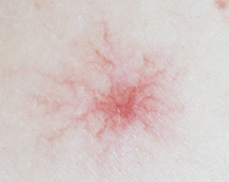
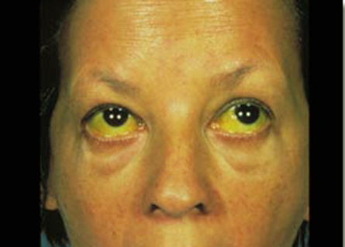
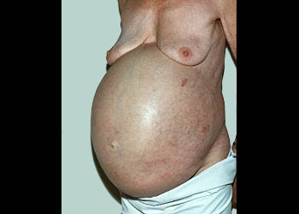
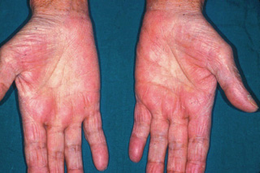
Physical Exam Findings

Slide 32
Liver-Specific Laboratory Findings
Laboratory Markers
Hepatic panel:
AST/ALT
ALP
Bilirubins
Gamma-glutamyl transpeptidase (GGT)
Coagulation/Hematology:
PT/INR, CBC (when asciites), platelets
Off of CHEM-12:
Albumin

Slide 33
Lab Data: Injury versus Function
INJURY
FUNCTION
Damage to hepatocytes
Toxins, viral, ischemia, alcohol, cholestasis
Measured by
Intracellular enzymes
↑AST > 3x ULN
↑ALT > 3x ULN
AST: ALT ratio > 2:1
↑ALP (+/- ↑ GGT)
VALUES CAN BE MUCH HIGHER
Measures ability of liver to perform normal daily functions
Measured by
↑ INR
↓ Albumin
↑ Unconjugated bilirubin
↑ Total bilirubin
Notes:
ULN upper limit of normal

Slide 34
Elevated Bilirubin
Increased bilirubin may result from
Blockage/damage in the biliary canal (gall stone, tumor)
Loss of liver function leading to decreased conjugation
Increased RBC destruction (hemolytic anemia)
Conjugated bilirubin eliminated via the bile duct
Gives stool its brown color, urine its yellow color
As the liver is damaged, less bilirubin is conjugated
Have more unconjugated bilirubin
As more hepatocytes die, conjugated bili also released
Circulates the yellowing agent
See jaundice of skin/eyes, cola-colored urine, pale stools, itchiness

Slide 35
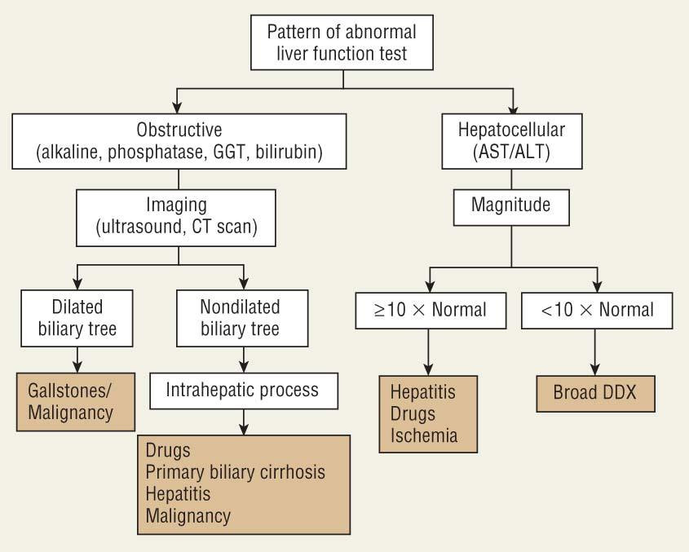
Utility of The Bilirubins in Liver Disease
Sease JM. In Pharmacotherapy, 8th edition, 2011.
Can use for diagnostic purposes
If conjugated bilirubin elevated, sure sign of liver disease
↑ conjugated plus ↑ AST/ALT = significant liver injury
↑ conjugated plus ↑ ALP = cholestatic disease
↑ unconjugated = possible hemolysis

Slide 36
Other Lab Changes
Coagulation Studies
Albumin
↑ bleeding as normal liver synthesizes clotting factors
Liver disease reduces synthesis, increases fibrinolysis, affects platelets
Most common: factor VII deficiency (60% of cases); this is a poor prognostic sign
PT used in Child-Pugh scoring, INR in MELD
Thrombocytopenia: up to 70% of cirrhotic patients
Most abundant protein in circulation
Main physiologic function: maintain colloid osmotic pressure
Other functions:
Transport of various molecules
Antioxidant/anti-inflammatory
Improve diuretic response
Wong F. Natl Clin Pract Gastroent Hepatol 2007;4(1):43-51.

Slide 37
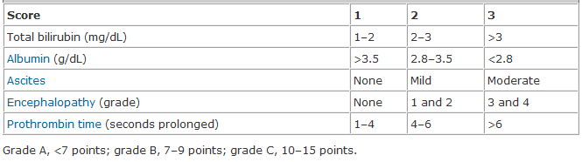
Child-Pugh Scoring versus MELD
MELD: Model for End-Stage LD
Uses bilirubin, INR, SCr to prioritize transplant candidates
Range of points: 6 (less ill) to 40 (gravely ill)
Child-Pugh:
Grade C survival 45% @ 1 year, 35% @ 2 years

Slide 38
Vascular Changes in Cirrhosis
Alterations in portal system and systemic circulation
Vasodilation, decreased response to vasoconstrictors, formation of new BVs
Manifests as increased portal flow, varices formation, and variceal bleeding
Above alterations are what leads to portal hypertension

Slide 39
Major Sequelae of Cirrhosis/ESLD
Portal hypertension
Gastroesophageal varices
Ascites
Spontaneous bacterial peritonitis
Hepatorenal syndrome
Hepatic encephalopathy
Coagulation defects

Slide 40
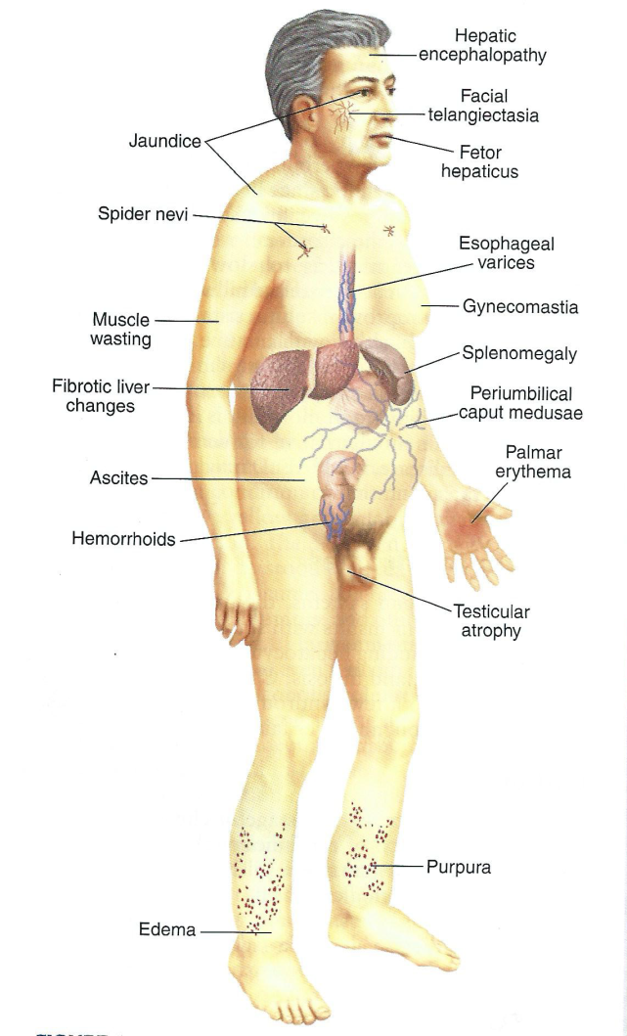
Other Sequelae/Terms
Telangiectasia: “spider veins”
Fetor hepaticus: “fruity breath”
Purpura: red/purple disclorations from broken BVs
Spider nevi: like telangiectasias but when blanched fill from center, not periphery
Periumbilical caput medusae: raised palm tree vasculature with distended/engorged veins
In: Porth. Essentials of Pathophysiology, 3rd edition, 2011.

Slide 41
Management/Treatment of Cirrhosis and ESLD

Slide 42
Flow of ESLD/ Cirrhosis
Portal Hypertension
Poor Liver Function
Ascites
Low Albumin
Varices Formation
Spontaneous Bacterial Peritonitis (SBP)
Altered Metabolism & Elimination
Hepatic Encephalopathy
Chronic Varices
Coagulation Disorders
Bleeding Varices

Slide 43
Portal Hypertension
Defined as gradient between portal/central pressures > 5 mmHg
Gradient @ 8-10 mmHg = varices
Gradient > 12 mmHg = active bleeding
3 types:
Prehepatic: i.e., splenomegaly, thrombosis of portal vein
Posthepatic: i.e., right sided heart failure
Intrahepatic: i.e., cirrhosis

Slide 44
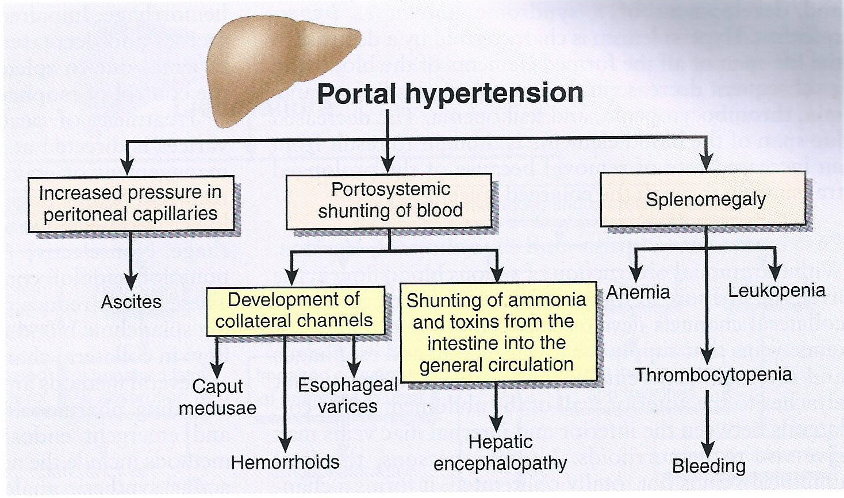
Portal HTN: Pathophysiology
Porth CM. In Essentials of Pathophysiology, 3rd edition, 2011.

Slide 45
Portal HTN: Pathophysiology
Resistance to portal blood flow
Inflammation, fibrosis scarring of liver tissue
Vasoconstriction within liver (↓ nitric oxide)
Increased portal blood flow
Vasodilation of splanchnic (portal) vessels
Collateral vessels form away/around the liver
See formation of gastroesophageal varices

Slide 46
Cirrhosis
Reduced blood flow through liver
Portal Hypertension
>10 mmHg
Pooling of Blood
Vasodilation of splanchnic, mesentery, abdominal veins
Collaterals
Collaterals
Formation, enlargement & engorgement of collateral blood vessels
Gastroesophageal Varices
Notes:
Portal hypertension >12 mmHg
Collateral Formation
Lower esophagus, stomach, abdomen, spleen
Engorgement of small capillaries along GIT
Overfilled blood vessels likely to rupture
Severe bleed, Hemorrhage

Slide 47
Gastroesophageal Varices
Varix/varices = dilated vein
Result of increased portal pressure
> 10 mmHg
Collateral vessels develop
Shunt blood away from (and around) the liver and back to the heart
Varices can develop in the gastric, esophageal, or rectal regions
Notes:
40:00

Slide 48
Gastroesophageal Varices
50% of patients have varices at cirrhosis diagnosis
Increased pressure in collaterals can lead to rupture and bleeding
30% lifetime risk of bleeding
70% chance of rebleeding
Mortality: 25-50% with each bleed
Notes:
41:10

Slide 49
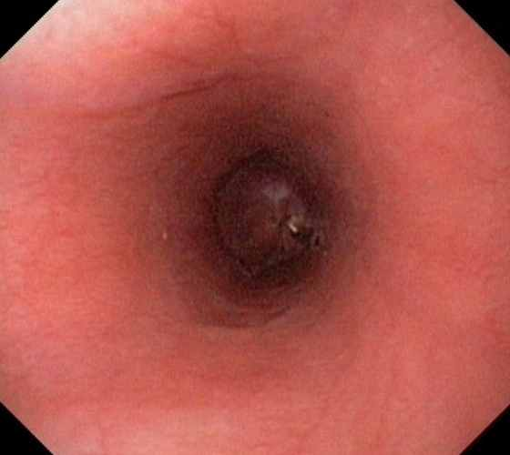
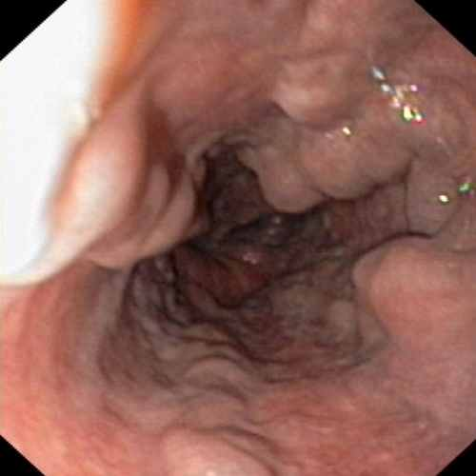
Gastroesophageal Varices
Normal esophagus
Esophageal varices
Notes:
43:00

Slide 50
G/E Varices: Goals of Management
Primary prophylaxis
Prevent first bleed
Keep portal pressure < 12 mm Hg
Treat any acute bleed
Secondary prophylaxis
Prevent a second bleed in patients that have already had one episode

Slide 51
G/E Varices: Management
Prevention of First Bleed
FIRST LINE THERAPY: NONSELECTIVE BBs
Utilized to block B2 receptors located on splanchnic vasculature, resulting in splanchnic vasoconstriction
Reduce portal venous outflow (splanchnic blood flow)
Propranolol 20 mg PO BID; max 80 mg BID
Nadolol 40 mg PO Daily; max of 160 mg daily
Doses of beta-blockers may be titrated up every 2-3 days until goals are achieved
Watch clinical tolerance, HR (keep at > 55 bpm), BP

Slide 52
G/E Varices: Primary Prophylaxis
Monitoring of BBs
HR, BP
SOB, bronchoconstriction
Fatigue, vivid dreams
50% reduction in risk of first bleed
Patients at highest risk = most benefit
Bosch J. Journal of Hepatology 2000; 32(S1):141-156.

Slide 53
G/E Varices: Acute Bleed
Treatment of acute bleed
Acute esophageal variceal hemorrhage is a medical emergency
Patients present with hematemesis or melena
Treatment goals:
Stop or slow blood loss
Fluid resuscitation
Correct coagulopathy
Prevention infection
Prevent rebleeding

Slide 54
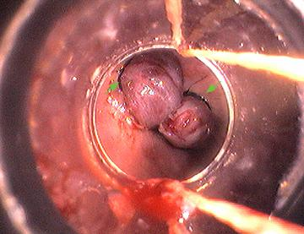
G/E Varices: Acute Bleed Treatment
Octreotide
Endoscopic Band Ligation (EBL)
A long acting synthetic analog of somatostatin
MOA: reduces portal pressure and collateral blood flow through vasoconstriction of splanchnic vasculature
Dose: 50 mcg IV bolus followed by an infusion of 50 mcg/hour x 3-5 days
Most effective intervention to stop bleeding
Wrap two or more rubber bands around the esophageal mucosa that contains the bleeding varix
This leads to necrosis within a few days and ulcer healing in 14-21 days

Slide 55
G/E Varices: Acute Bleed Treatment
Fluid resuscitation
IVF, blood products
Correct coagulopathy
Vitamin K, platelets, FFP
Prevent infection
High risk of developing infections during acute variceal bleed
Infections are associated with poorer outcomes
Give antibiotics during acute treatment of variceal bleed to prevent infection (Discussed under SBP section)

Slide 56
G/E Varices: Prevent 2nd Bleed
Highest risk of rebleed within 3 to 10 days after first bleed
50% of rebleeds occur in first 10 days
Non-selective BB plus EBL procedure
Risk of rebleed only 15-20% if on BB plus EBL
Drugs, doses, titration, monitoring as stated previously
Keep portal pressure < 12 mmHg
Sharara AI. NEJM 2001;345:669-681.
Notes:
52:30

Slide 57
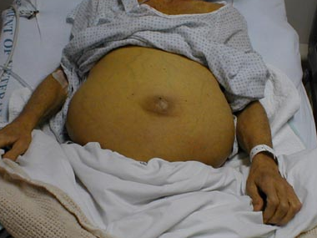
Ascites
Accumulation of fluid in peritoneal cavity
Affects 50% of cirrhotic patients within 10 years of diagnosis
Most common complication of cirrhosis
Associated with decreased QOL, infection, renal dysfunction
Poor prognostic sign
Krige JEJ. BMJ 2001;322:416-418

Slide 58
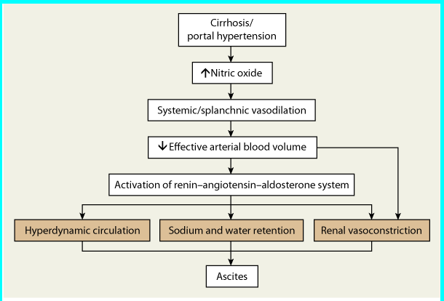
Development of Ascites
Sease JM. In Pharmacotherapy, 8th edition, 2011.

Slide 59
Ascites: Pathophysiology
Portal Hypertension → Splanchnic vasodilation
Mediators: Nitric oxide, glucagon
Results in blood pooling within splanchnic circulation
Results in increased capillary pressure and permeability, pooling of lymph and serous fluid into peritoneal space
Splanchnic vasodilation → “effective hypovolemia”
↓ Arterial blood volume, hypoperfusion
↓ BP
Activation of the RAAS system

Slide 60
Ascites: Assessment
Assess ascitic fluid
Serum-Ascites Albumin Gradient (SAAG)
SAAG reflects differences in oncotic pressures and correlates with portal venous pressure
SAAG = Albumin_{(serum)} – Albumin _{(ascites)}
SAAG ≥ 1.1 g/dL suggests portal HTN with 97% accuracy
Rule out spontaneous bacterial peritonitis
Baseline Measurements
Renal function (SCr, BUN, CrCl/GFR)
Electrolytes (K, Mg, Na)
Blood pressure

Slide 61
Ascites: Management
Aldosterone blockade
Moderate ascites: Spironolactone 50 - 200 mg daily
Large ascites: Spironolactone 200 – 400 mg daily
Diuresis
Moderate ascites: Furosemide 20 – 80 mg daily
Large ascites: Furosemide up to 160 mg daily
USE TOGETHER; single use of either agent not as effective
Recommended ratio of spironolactone to furosemide: 100 mg:40 mg
Runyan BA. AASLD Guidelines. Hepatology February, 2013
Notes:
14:00

Slide 62
Ascites: Management
Non-Pharmacologic
Abstinence from alcohol
Low-sodium diet < 1-2 g/day
Fluid restriction < 1000 ml/day
Only if serum Na⁺ < 120 mmol/L
Paracentesis
Rapid removal of fluid from peritoneal space
Preferred method in large volume ascites
See rapid fluid shift from vascular space to peritoneal space
Albumin
Only indicated if > 5 L removed during paracentesis

Slide 63
Spontaneous Bacterial Peritonitis
Occurs in 20-30% of patients with ascites
Associated with 70% recurrence within one year of first episode
Bacterial infection of the ascites fluid and peritoneal space
Bacteria can move easily from the GIT to circulation through collaterals
Escherichia coli, Klebsiella pneumonia, pneumococci
Immune system dysfunction
Inflammation
Notes:
1531

Slide 64
Spontaneous Bacterial Peritonitis
Risk Factors
Ascitic fluid protein concentration < 1 g/dL
Variceal Bleed
History of SBP
Signs/symptoms of infection
↑ WBC, fever
Abdominal pain, N/V
New-onset, rapid ascites
New-onset encephalopathy, GI bleed, renal dysfunction
Gines P. NEJM 2004;350:1646-54.
Notes:
18:00

Slide 65
Spontaneous Bacterial Peritonitis
If suspected, treat immediately after ascites fluid is taken for diagnosis
Do not wait for cultures or cell counts
Ascitic fluid diagnosis
↑ PMN count > 250/mm³
(+) Ascitic fluid cultures
E. coli, Klebsiella pneumoniae, Streptococcus pneumoniae, enterococci
Notes:
21:00

Slide 66
SBP: Treatment
Empiric antibiotic therapy
3rd generation cephalosporins:
Cefotaxime 2 g every 8 hours
Ceftriaxone 1-2 g every 24 hours
Fluoroquinolones: use in PCN allergy only
Ofloxacin 400 mg every 12 hours
Ciprofloxacin 500 mg every 12 hours

Slide 67
SBP: Treatment
Duration of antibiotic therapy
5 days if blood/ascites cultures remain negative
5-10 days if blood/ascites cultures are positive
Antibiotic treatment during variceal bleed:
Prevent infection during acute bleed
Same antibiotic agents
Culture not necessary
Duration: 5-10 days

Slide 68
SBP: Treatment
Albumin:
IV infusion improves mortality in SBP
Doses:
Day 1: 1.5 g/kg x 1 dose
Day 3: 1 g/kg x 1 dose
Notes:
Bilirubmin > 4
Scr > 1
BUN > 30

Slide 69
SBP: Long Term Prophylaxis
Recurrence without prophylaxis = 70% → 20%
Goal: intestinal decontamination
Target patients with history of SBP infection to prevent recurrence
Long-term prophylaxis therapy
Norfloxacin 400 mg daily (preferred) or cipro
TMP-sulfa DS (160mg/800mg) daily
Notes:
30:00

Slide 70
Hepatorenal Syndrome
Renal failure seen in terminal liver disease
Progressive azotemia
Increased SCr
Oliguria
Pathophysiology: thought to be caused by decreases in renal blood flow
When renal failure superimposed on liver failure, see azotemia, hyperammonemia
Contributes to hepatic encephalopathy/coma

Slide 71
Hepatic Encephalopathy
Major neuro-psychological complication of cirrhosis
Accumulation of toxins that are normally removed by the liver
Ammonia is the most widely implicated toxin
Made by bacteria in the GI tract
See ↑ ammonia in circulation
Poor hepatic function and metabolism
Collateral shunting around liver
Notes:
3514

Slide 72
HE: Pathophysiology
Normal liver converts ammonia to urea
Ammonium ion produced in GIT, diffuses into portal system, converted to urea, enter general circulation, excreted
When blood is shunted and bypasses liver, ammonium goes right to general circulation an then into cerebral circulation
Once in cerebral circulation, symptoms manifest

Slide 73
Hepatic Encephalopathy
Precipitating factors
Oral protein load
GI bleed
Use of sedatives (benzodiazepines, opiates)
TIPS, shunting procedures
Infection
Progression of cirrhosis

Slide 74
Hepatic Encephalopathy
Clinical features
Altered mental status, mood change, lethargy, dementia, sleep disturbance, speech disturbances, memory deficits
Physical exam
Asterixis (“liver flap”), ataxia, coma
Laboratory values
Ammonia levels poorly correlate with clinical response

Slide 75
HE Treatment: Lactulose
Ammonia lowering with lactulose
Lactulose syrup (10 g/15 mL)
Nonabsorbable disaccharide
First line acute and chronic therapy
Lactulose is converted to organic acids = ↓ gut pH
↓ pH = protonation of ammonia
↓ pH = bacterial killing
Converts NH₃ → NH₄⁺ (non-absorbable ion)
Laxative effect = elimination of ammonia

Slide 76
HE Treatment: Lactulose
Dose: 15-45 mL PO every 8 hours
Lactulose enemas may be used if unable to take PO or NG solution
Titrate dose to produce 2-4 soft, formed BMs daily
Side effects
Flatulence, diarrhea, hyperglycemia, abdominal pain
Monitoring
Resolution of CNS symptoms,
# bowel movements/day, diarrhea J
Bass NM. NEJM 2010; 362(12):1071-81.

Slide 77
HE Treatment: Rifaximin
Oral, non-absorbable intestinal antibiotic
Kills gut bacteria responsible for ammonia production
Treatment of HE:
Mono- or combo- therapy with lactulose
400 mg po TID
Prophylaxis of HE after first episode:
Combo therapy with lactulose is most common
550 mg BID
Bass NM. NEJM 2010; 362(12):1071-81.

Slide 78
HE Treatment: Rifaximin
Potential risk of C. diff infection with prolonged use
Side effects
Headache
Monitoring
Resolution of CNS symptoms
KEY TO HE: TREAT PATIENT, NOT AMMONIA LEVEL
Notes:
C diff: tx metronidazole
Vanco

Slide 79
HE: Miscellaneous Drugs
Neomycin: 3-6 grams po daily x 1-2 weeks
Aminoglycoside
Not first-line; use in lactulose-refractory cases
Irreversible ototoxicity
Nephrotoxicity
Risk of superinfection
Metronidazole: 250 mg po BID
Neurotoxicity 2° to impaired hepatic clearance precludes use

Slide 80
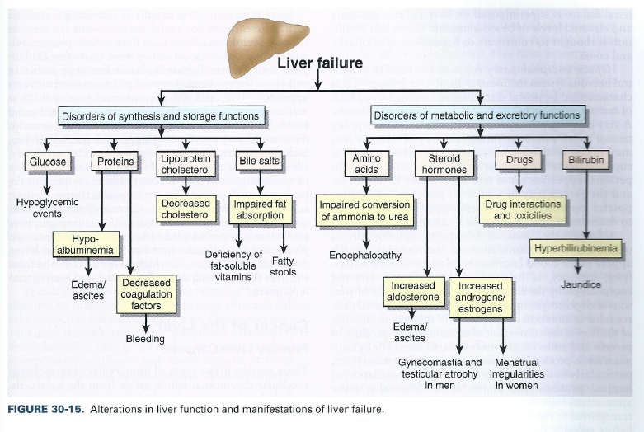
Summary
Porth CM. In Essentials of Pathophysiology, 3rd edition, 2011.

Slide 81
Practice Case To Be Posted on BB

Slide 82

Questions?

